Slide 1
Owners
Founded by Adib Salim, Gary Liggins, and Shane Mooney, Supreme Team LA has been the premiere entertainment curator in Los Angeles nightlife/hospitality for over 10+ years. The experiential marketing and promotional company has produced some of the most successful and highly sought-after events that Los Angeles has witnessed from nightclub promotion, restaurant branding/marketing, brand integration and private events at high end restaurants and event spaces such as: Supperclub, Roxbury, EP&LP, Hyde, Doheny Room, Lock and Key, Aventine, Madera Kitchen, Avenue, Warwick, Blind Dragon, The Peppermint Club, Sunset Room, Le Jardin, Playhouse, The Chinese Theatre, Penthouse, Ballet, Conga Room, Microsoft Theatre, Belaso, Avalon, Tiffany’s on Vine, The Mondrian, SLS hotel, W Hotel Hollywood, The Roosevelt Hotel and more.
Supreme Team LA specializes in concierge, liaison and event planning services for celebrities, athletes, liquor companies, record labels and more. Generating over tens of millions of dollars for the Los Angeles nightclub & restaurant industry and receiving noteworthy press, Supreme Team LA has its pulse on the L.A. scene. Comprised of Los Angeles natives, Supreme Team LA knows how to appeal not only to locals on a weekly basis but also garner attendance from A-list Athletes, Celebrities, Models and entertainment personalities from around the world. Supreme Team LA outstanding reputation in the events and entertainment sectors ensures their ability to manage and transform Social House Lounge into a profitable and notable venue in the Los Angeles market. The team plans to launch multiple locations across California and expand into a national experience.

Slide 2
CFO
Don Fields serves as the CFO of the promotional group. With a MBA Finance degree from the University of Washington and over 15 Years in the Hospitality arena Don has been responsible for opening three of the top grossing and most profitable restaurants in Southern California. Serving as General Manager in Operations for Brinker he then joined the Beverly Hills Food Company as Controller where he was responsible for developing and overseeing the Financial Operations of the Largest Grossing Opening Southern California has seen. Bottega Louie began as a $12.5 Million Full-Service Restaurant located in Downtown LA. From Bottega Louie he furthered his career as CFO for Drai’s Enterprises where he oversaw all financial operations and general business management for the portfolio. Once Drai’s permanently relocated to Las Vegas for operations Don accepted a new position as CFO for Matthew Kenney Cuisine. Under his supervision the brand expanded from 2 locations to 26 international restaurants and generated over $74 Million and 15% EBIDTA in revenue streams. Don later became the Operational Director the Consulted Sprout Restaurant Group (properties include Bavel, Rose Café, Republique, Bestia, Vespertine). Presently, Don is the Regional Finance Director for Compass Group where he manages $100 Million in Business and oversees all operations for the company. With a celebrated career of accomplishments in the financial and operational industry, Don is poised to do the same for our venue/brand. A&G Group has also enlisted the innovative architectural firm Spacecraft Design Group to design and construct our venue. Spacecraft has been responsible for designing hundreds of restaurant and retail spaces around the world.

Slide 3
Design Concept
Industrial chic and modern rustic design will give the venue a warm feeling with wood and stone undertones. Large windows that can be fully opened will create an outdoor experience for diners inside. Social House’s elegant décor is suitable for a casual brunch, sporting events viewing or a beautiful evening with music for every musical palette. The industrial design will be comprised of concrete, copper, piped A/C units and raw earthly elements creating a modern dining experience.
the décor will be created partially by artists with their works being on display in the main dining area, also artwork of influential sports figures. Combining rustic and industrial designs Social House brings the excitement of the inner city capturing the grit and glam through local artists artwork as well. It’s everything patrons could ask for in a restaurant/lounge whether they’re celebrating a casual outing or dressing up for a night on the town
Venue will also feature a separate lounge/patio area that will feature everything from live music to Dj’s depending on the event. food and drinks being served outside along with bottle service option officially making social house the perfect place for any occasion. Venue will offer a variety of seating from booths on one side of the venue to built in tables along the other side of the restaurant. Table- tops will be placed in the middle of the restaurant that offer multiple configurations depending on the size of your event/party. With multifunctional furniture Social House can transform from a dinning experience to a private event space with ease. Venue will offer televisions just to make sure we do not have to close or slow down business when big sporting events are on, truly making Social House a multifunctional lounge built to generate revenue from all directions and giving consumers multiple reasons to come back day and night

Slide 4
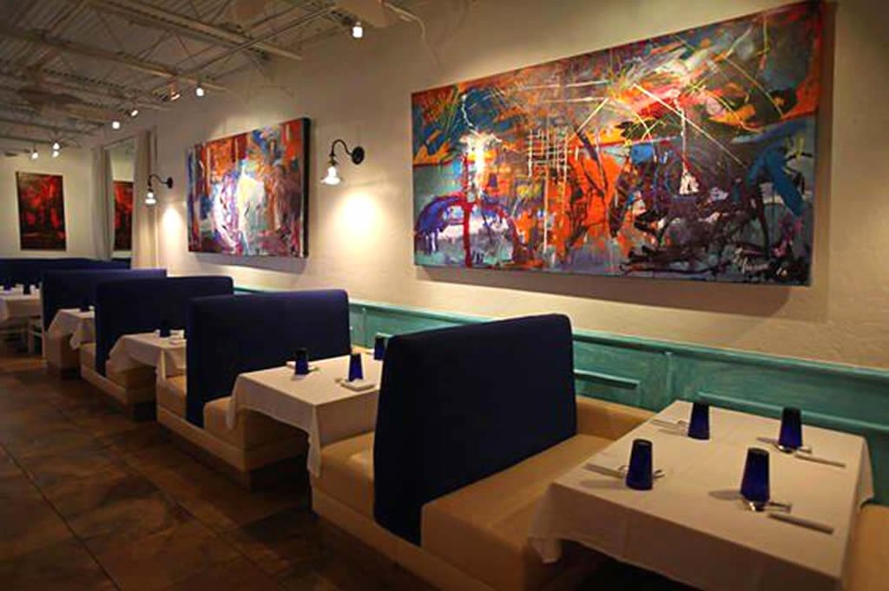
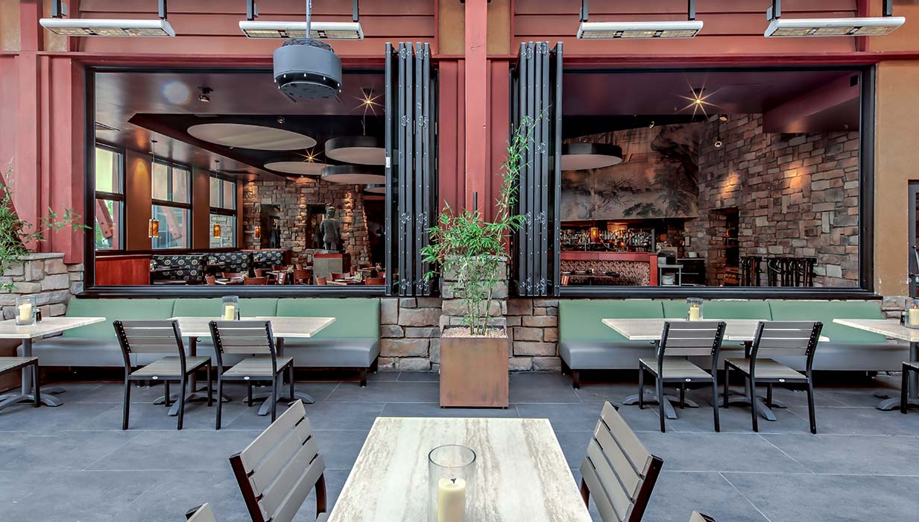
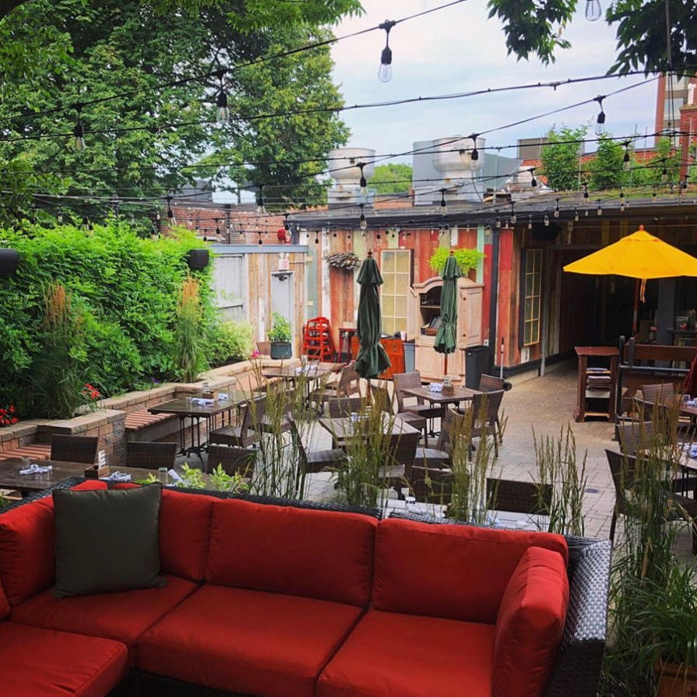
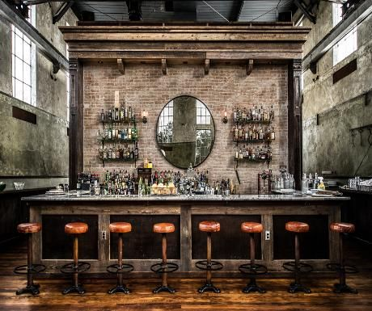
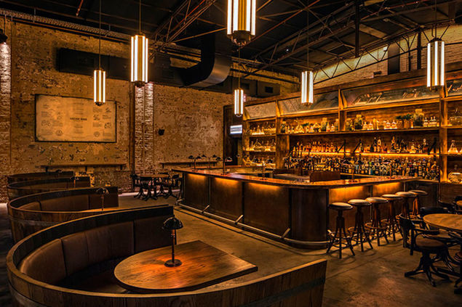
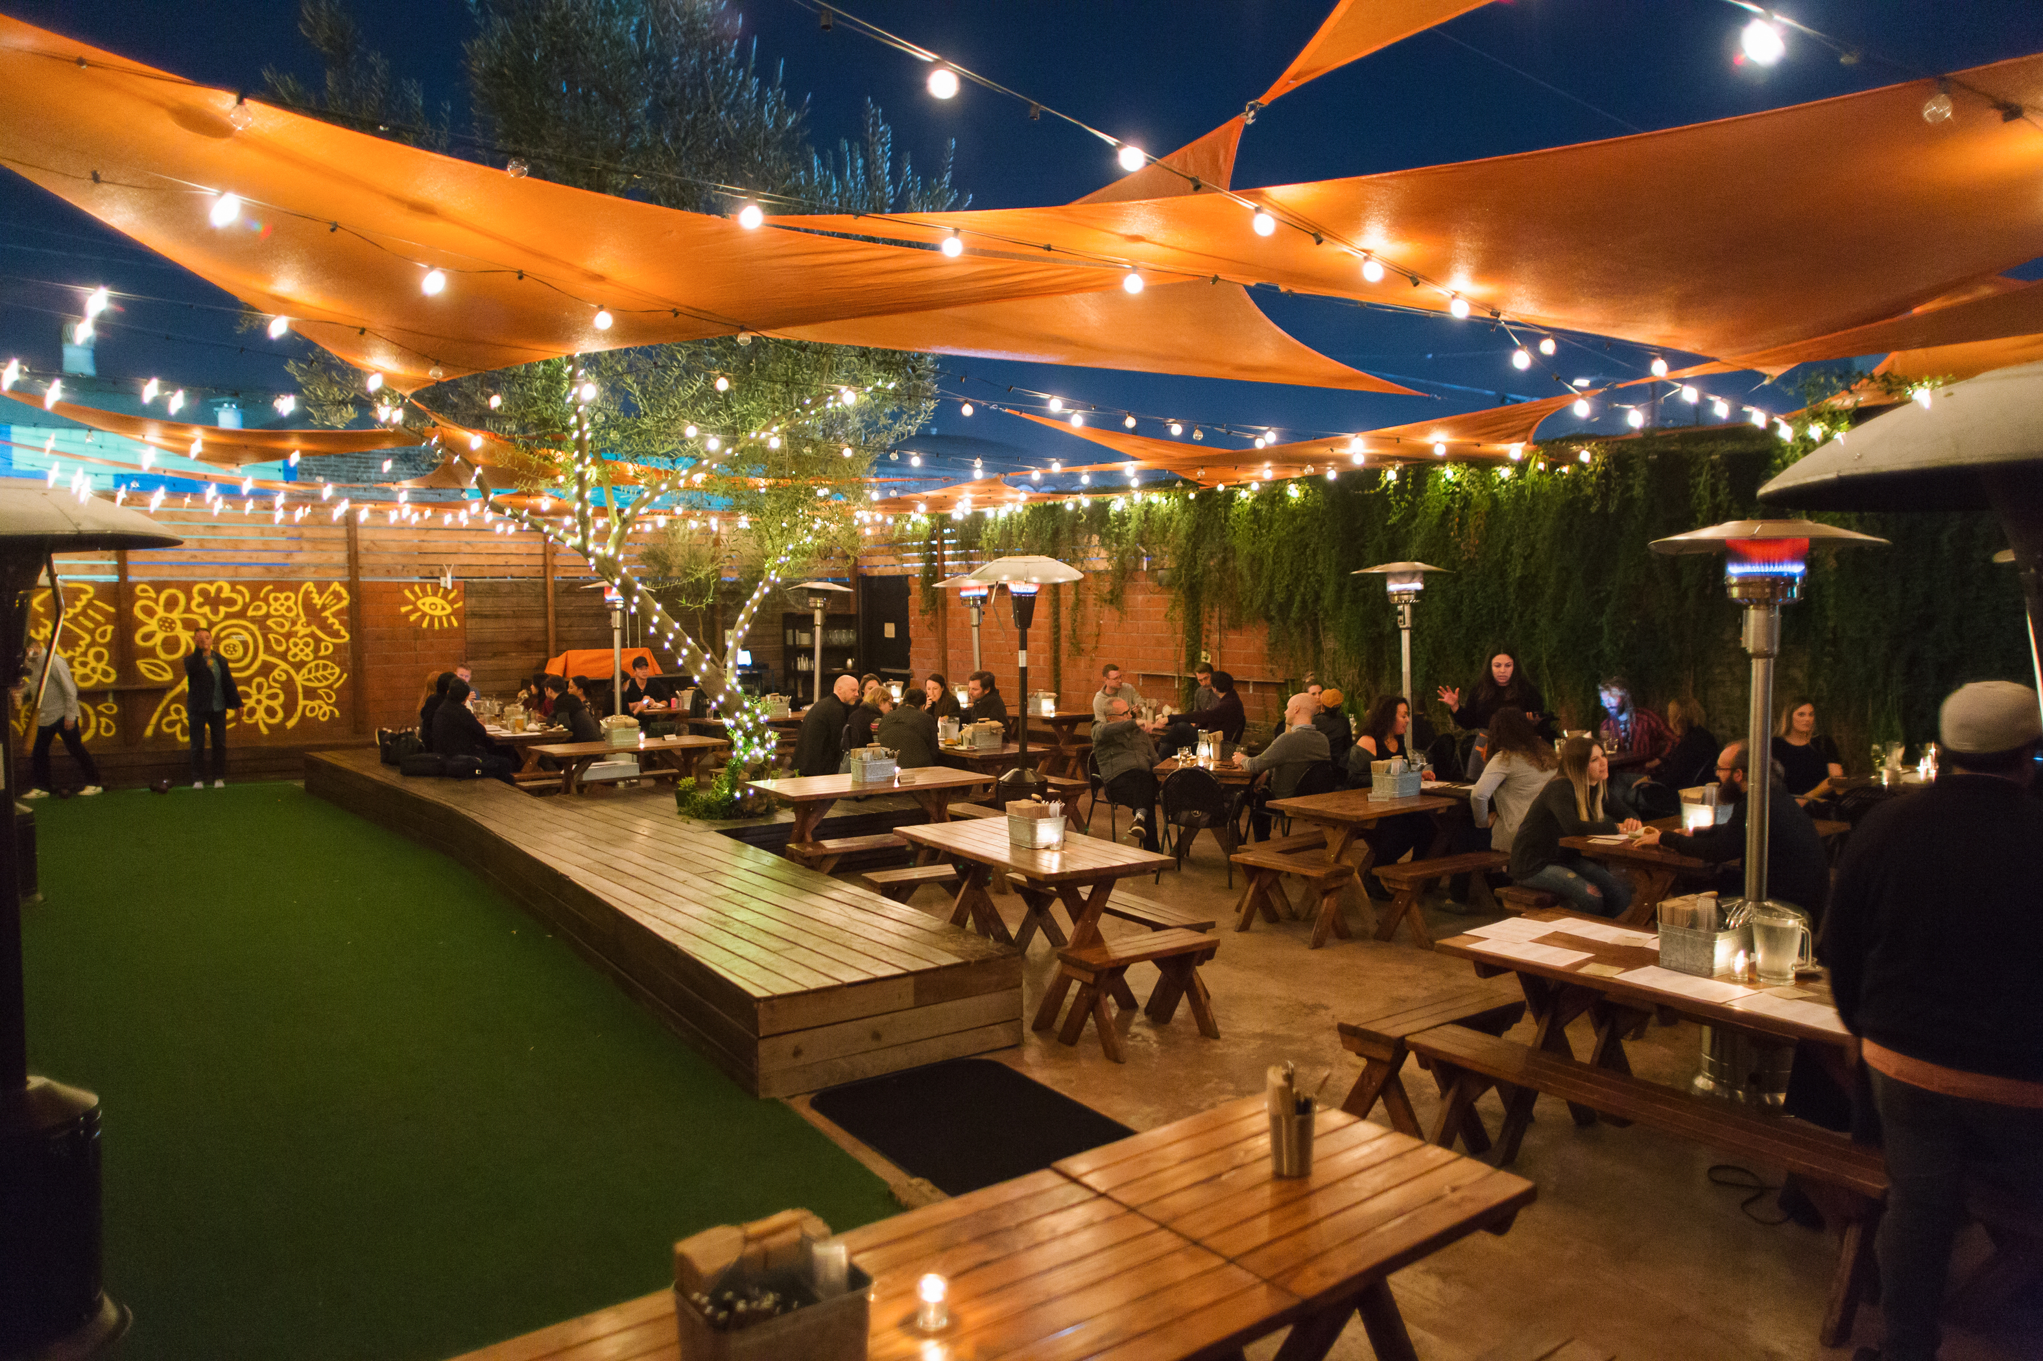
Art on the walls in Dining area
Large Windows
Patio
Rustic Design
Rustic Design
Patio

Slide 5
Social House LA Operating Hours and Schedule This is a tentative schedule intended to reflect the ability to operate 7 days a week with entertainment-based programming
**ALL SPORTING EVENTS WILL BE SHOWN SCHEDULE CAN BE ALTERED TO REFLECT MAJOR SPORTING EVENTS **
Monday 4pm -7pm Happy Hour; 10pm – close Late Happy Hour
Tuesday 4pm – close Taco Tuesday Happy Hour. Playlist curated by Top DJ’s. Special weeks with special guest DJ set.
Wednesday 4pm – close Wine Down Wednesdays & Happy Hour ½ price on beer and wine all night. 4pm-7pm normal happy hour. Jazz and R&B music curated playlist or live band.
Thursday 4pm – 7pm Happy Hour; 10pm – close Late Happy Hour.
Friday 4pm – 7pm Happy Hour. Close at 2am with playlist curated by Top DJ’s. Close 2am. Playlist curated by Top DJ’s. Special weeks with a special guest DJ set.
Saturday 11am – 3pm Brunch. 3pm – close playlist curated by Top DJ’s. Special weeks with a special guest DJ set.
Sunday 11am – 3pm Brunch. 3pm – 8pm open. 8pm – close Supreme Lounge 90s – Early 2000s music with special guest DJ sets.

Slide 6
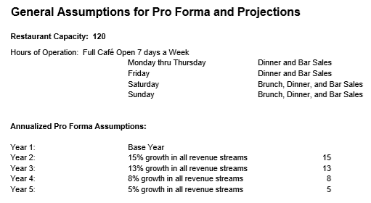
Capacity, Operating Schedule and Yearly Growth

Slide 7
Sales itemized by Per Person, Day, Week and Year
Total Capacity | 120
Brunch Avg Seating | 100
Dinner Avg Seating | 100
Bar Sales Avg Seating | 120
Operational Weeks | 51
Guest Average | Total PPA | Food | Beverage
Brunch PPA | $ 60.00 | $ 30.00 | $ 30.00
Dinner PPA | $ 70.00 | $ 40.00 | $ 30.00
Bar Sales PPA | $ 40.00 | $ - | $ 40.00
PEAK SALES
Table Turns | Brunch | Dinner | Bar Sales |  | Brunch Food | Dinner Food | Brunch Beverage | Dinner Beverage | Bar Sales Beverage | Total Revenue
Monday | 0 | 1 | 0.5 |  | $ - | $ 4,000 | $ - | $ 3,600 | $ 2,400 | $ 10,000
Tuesday | 0 | 1.5 | 2 |  | $ - | $ 6,000 | $ - | $ 5,400 | $ 9,600 | $ 21,000
Wednesday | 0 | 1.5 | 1 |  | $ - | $ 6,000 | $ - | $ 5,400 | $ 4,800 | $ 16,200
Thursday | 0 | 2 | 2 |  | $ - | $ 8,000 | $ - | $ 7,200 | $ 9,600 | $ 24,800
Friday | 0 | 2 | 2 |  | $ - | $ 8,000 | $ - | $ 7,200 | $ 9,600 | $ 24,800
Saturday | 2 | 2 | 2 |  | $ 6,000 | $ 8,000 | $ 6,000 | $ 7,200 | $ 9,600 | $ 36,800
Sunday | 2 | 2 | 2 |  | $ 6,000 | $ 8,000 | $ 6,000 | $ 7,200 | $ 9,600 | $ 36,800
 |  |  | Total Weekly Sales |  | $ 12,000 | $ 48,000 | $ 12,000 | $ 43,200 | $ 55,200
 |  |  | $ 170,400.00 |  |  |  |  |  |  |  | Total Yearly sales by item
 |  | Estimate Annual Sales |  |  | Brunch Food | Dinner Food | Brunch Beverage | Dinner Beverage | Bar Sales Beverage |  | Brunch | Dinner | Bar Sales
Peak Sales |  | $ 8,690,400 |  |  | $ 612,000 | $ 2,448,000 | $ 612,000 | $ 2,203,200 | $ 2,815,200 |  | $ 1,224,000 | $ 4,651,200 | $ 2,815,200
Total Restaurant Sales |  | $ 8,690,400 |  |  | $ 612,000 | $ 2,448,000 | $ 612,000 | $ 2,203,200 | $ 2,815,200

Slide 9
Investment Summary with Net Profit
Investment Breakdown
Total Capital Investment - $900,000.00
Construction costs - $450,000.00 – this is an estimate, depending on how much work is needed on the final location it could be lower
Rental deposit - $100,000.00 – rental deposits are 3-6 months of rent, could be lower depending on final location
Liquor license - $50,000.00 - if we find a location that comes with the liquor license, this cost may not apply
Contingency - $200,000.00 – money that should be put aside for unforeseen costs
Pre-opening labor - $100,000.00 – money that should be put aside to maintain payroll before opening, training and for the first few weeks until revenue is generated

Slide 10
The Ideal investment opportunity would be a 70/30 split. The idea would be to reinvest profits and open multiple locations in California and other markets with the same concept or different concepts with the same or similar numbers. We believe after the first year we can get one location open per year which would double the investors profit with each location open.
Areas of opportunity (All areas where we have network and connections)
Los Angeles, Studio City/Sherman Oaks, San Diego, Houston, Dallas, Phoenix/Scottsdale, Miami, Atlanta, Orange County (CA), Inland Empire (CA)

Slide 11
Total Expenses – Per Year These expenses are the MOST it can cost to operate, depending on the venue theme and location, and with Supreme Team doing the Marketing and promotion and using our network some of these costs will be a lot lower, these costs are here to understand the potential FULL costs of operations

